Slide 1
Social Buzz
Presented by: Shaikh Mariya
Last Updated: June 16th ,2022

Slide 2
Table of Contents Social Buzz
Analysis of the Content Categories of Social Buzz
Findings from the Data of Social Buzz
Conclusion
Appendix

Slide 3
Objective
An analysis of the content categories of Social Buzz that highlights the top 5 categories with largest aggregate popularity.

Slide 4
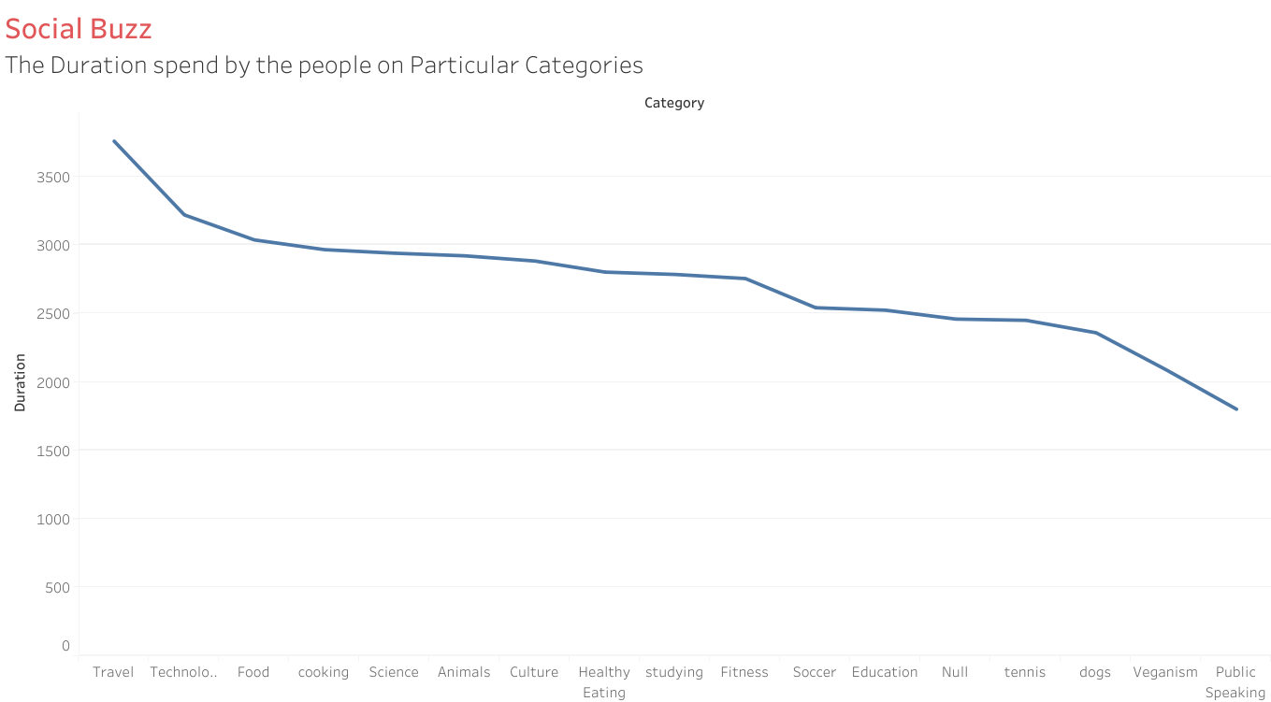
From the chart between content and the duration spend by the audience of Social Buzz, I can conclude that the duration spend by the audience is greater on the
Contents Travel, Technology,
Food, Cooking, Science and
Animals while it is lowest on
Public Speaking.

Slide 5
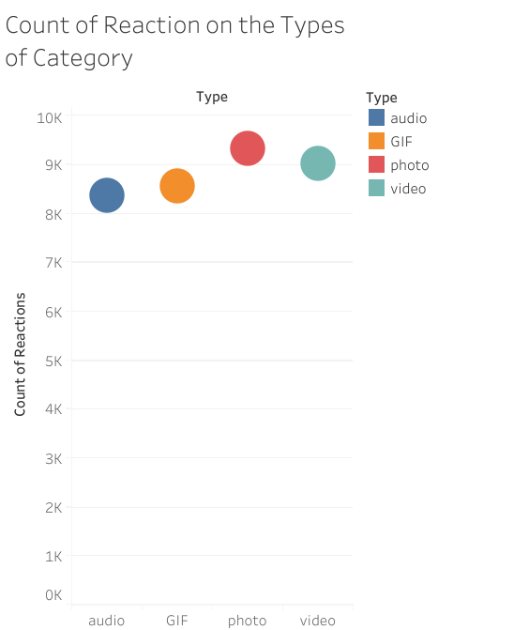
From the findings I can conclude
that the category Photo has
recieved the highest reaction count
meanwhile the Audio the lowest count
of reactions

Slide 6
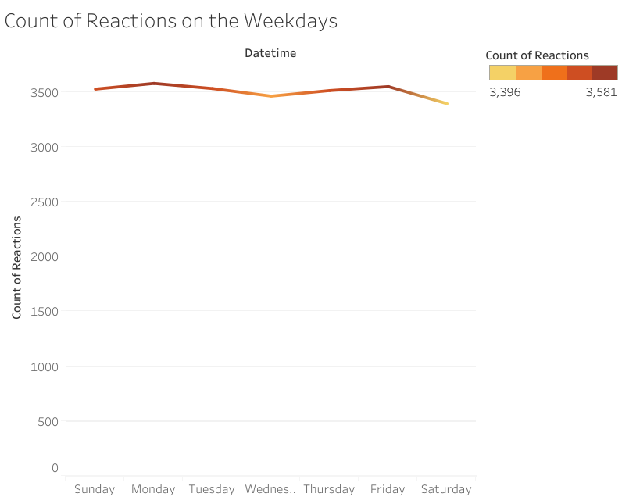
The contents of Social Buzz is
receiving the highest count of
reactions Monday and
Friday while the lowest count of
reaction on Saturday.

Slide 7
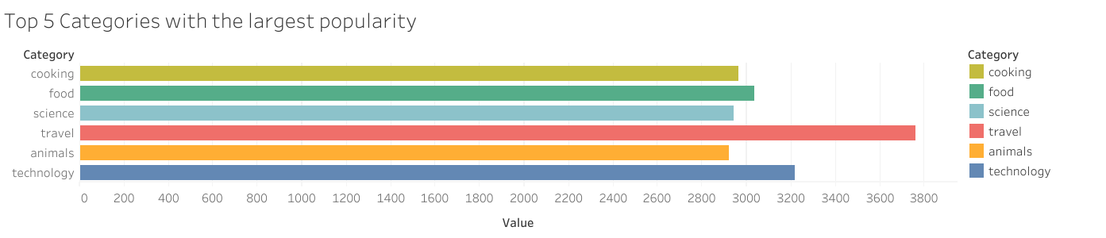
From the findings I can conclude
that the top 5 Categories of
Social Buzz is:
Travel
Technology
Food
Cooking
Animals

Slide 8
Findings:
The top 5 categories of popular content are Travel, Technology, Food,
Cooking, Animals, such that Social Buzz should post more content about them while improving the quality of other category.
The type of categories popular among the audience is in Photo format so the Social Buzz should focus more on it.
Social Buzz should improve their marketing skills on the weekday like Saturday by sending the notifications whenever they upload a new content.

Slide 9
Appendix:
The dataset was provided by the Social Buzz itself, I have cleaned and visualized the data to drive business conclusion

Slide 10
Thank You!
Any Questions?

